Slide 1

AIoT Enhanced Night Vision Object Detection for Vehicle Safety Using Transfer Learning on Raspberry Pi 5
Review – 1
Under the guidance of
Dr. Sujatha R
by
Kunal Chavan (21BEC0780)
Shivang Singh (21BEC0457)

Slide 2
Agenda
Team Member’s Contributions
Aim & Objectives
Literature Review
Significance/Novelty of Work
System Design
Flow Chart
Work Done
Results and Discussion
Timeline chart for paper drafting
References

Slide 3
Team Member’s Contribution
Kunal Chavan – Training of YOLO Model’s and Hardware Implementation.
Shivang Singh – Working on Literature Review and System Architecture.

Slide 4
Aim & Objectives
Developing an AIoT-based system that improves object detection under low-light or night-time conditions using advanced deep learning models like YOLO.
Utilize the computational capabilities of edge devices, specifically Raspberry Pi 5, to enable real-time object detection without relying on expensive or heavy computational resources.
Ensure the system contributes to improved vehicle safety by detecting objects in real time across various driving conditions.
Incorporate transfer learning to improve the accuracy and efficiency of object detection models while working within the constraints of compact devices.
Create a scalable and adaptive detection system capable of switching between different modes (traffic, highway, day, and night) based on environmental conditions and system time.

Slide 5
Literature Review
S.NO | Author Name | Title of the paper | Conference or Journal name with Year | Key points discussed & Gaps Identified
1 | Li, F., et al. | Vehicle Target Detection in Day-Night Mode Based on YOLOv5 | IEEE International Conference on Image Processing, 2023 | Fine-tuned YOLOv5 for day-night detection; lacked computational optimization for embedded systems.
2 | Jocher, Glenn, et al. | YOLOv5 | GitHub Repository, 2020 | Focused on ease of use and modularity; needed further optimization for dynamic environments.
3 | Bochkovskiy, Alexey, et al. | YOLOv4: Optimal speed and accuracy of object detection | arXiv, 2020 | Balanced speed and accuracy using SAM and PAN modules; limited optimization for resource-constrained devices.

Slide 6
Literature Review
S.NO | Author Name | Title of the paper | Conference or Journal name with Year | Key points discussed & Gaps Identified
4 | Redmon, Joseph, et al. | You Only Look Once: Unified, real-time object detection | IEEE CVPR 2016 | Revolutionized real-time detection; faced challenges with accuracy on smaller and overlapping objects.
5 | Redmon, Joseph, and Ali Farhadi | YOLOv2: Detecting objects from predicted anchor boxes | arXiv , 2016 | Improved accuracy with batch normalization; still had issues with cluttered scenes and object detection.
6 | Redmon, Joseph, and Ali Farhadi | YOLOv3: An incremental improvement | arXiv, 2018 | Added residual connections and multi-scale detection; required more computational power

Slide 7
Literature Review
S.NO | Author Name | Title of the paper | Conference or Journal name with Year | Key points discussed & Gaps Identified
7 | Girshick, Ross, et al. | Fast R-CNN | IEEE CVPR 2015 | Enhanced speed and efficiency with RoI pooling; still not ideal for real-time detection in resource-limited systems.
8 | Girshick, Ross, et al. | Rich feature hierarchies for accurate object detection and semantic segmentation | IEEE CVPR 2014 | Introduced R-CNN with hierarchical feature extraction; high computational cost limits real-time applications.
9 | Robert,K | Video-based traffic monitoring at day and night vehicle features detection tracking | IEEE International Conference on Intelligent Transportation Systems, 2009 | Proposed a hierarchical approach for vehicle detection in varied lighting; high computational requirements limit real-time use.
10 | Cortes, Corinna, and Vladimir Vapnik | Design of a mobile augmented reality-based indoor navigation system | ML,1995 | Introduced SVM for non-linear classification; struggles with large datasets compared to modern methods.

Slide 8
Significance/Novelty of Work
The project leverages AI and IoT to implement a real-time object detection system using Raspberry Pi 5 and YOLO models. It achieves high performance under resource constraints, making it suitable for cost-effective and compact vehicle safety systems, particularly in low-light conditions.
The system introduces a novel feature of dynamic mode switching between traffic and highway environments, optimizing the detection algorithm for different driving scenarios, reducing false positives in high-density traffic, and enhancing alert accuracy on highways.
By incorporating an infrared camera and transfer learning on YOLO models, the system effectively handles the challenges of low-visibility conditions, ensuring reliable object detection and distance measurement at night, which is critical for improving vehicle safety.

Slide 9
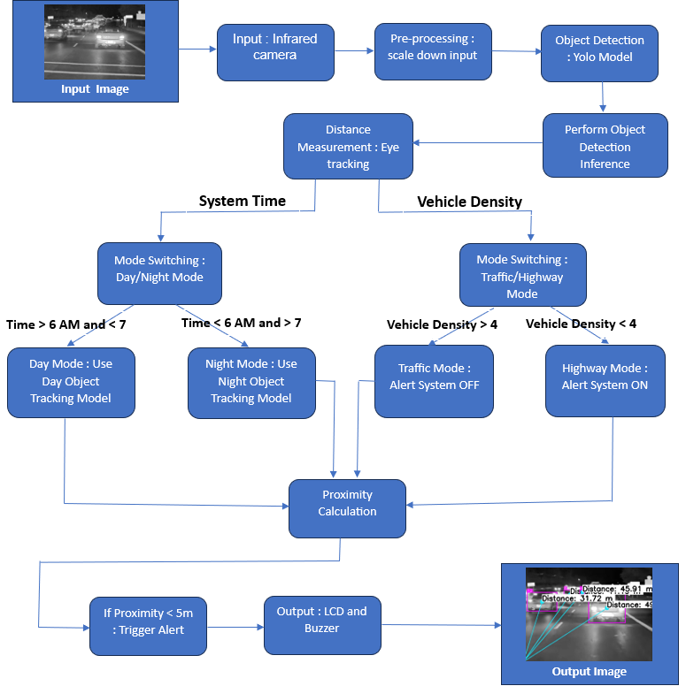
System Design

Slide 10
System Design
Infrared camera captures real-time images, especially in low-light conditions.
The input is scaled down for efficient processing.
YOLO model detects objects and performs inference.
Eye tracking calculates the distance to detected objects.
Based on system time, switches between day/night modes. Based on vehicle density, it toggles between traffic/highway modes.
Calculates object proximity and triggers an alert if within 5 meters.
Alerts (via LCD/buzzer) and displays distances with detected objects on an overlayed image.

Slide 11
Work Done
We have trained YOLOv5 and YOLOv6 on the FLIR images dataset and we have started the training of YOLOv7 and YOLOv8 and compare which models works better for this task.
Distance tracking needs to be more fine-tunined to get the more accurate distance between user’s car and the surrounding cars.

Slide 12
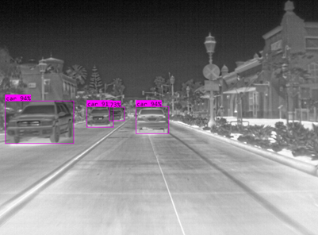
Results and Discussion
The object are detected successfully with their labels and confidence ratio in a preprocessed Forword Looking Infrared Image received from FLIR camera.

Slide 13
Results and Discussion
After Training YOLOv5 and YOLOv6 , we got these performance metrices and we deduced that we have obtained good precision , recall and F1-score but these models have performed poorly on mAP-50 andmAP-90 which needs to improved.

Slide 14
Timeline chart for paper drafting
Paper drafting to be done in October after we obtain the performance metrics for YOLOv7 and v8 models along with implementation of distance tracking.
Paper submission in an international conference in early November after review of the paper with our guide.

Slide 15
Sustainable Development Goals
Sustainable Development Goal – 9
Industry, Innovation, and Infrastructure
This project contributes to innovation in intelligent transportation systems (ITS) by the application of AI and IoT in vehicle safety. This system integrates advanced technologies like edge computing, transfer learning, and AI-based object detection to improve road infrastructure. It enhances the interaction between vehicles and their environment, allowing safer travel in low light conditions.
The innovation of using AI-enhanced night vision for vehicle safety exemplifies how emerging technologies can create resilient and safe transportation infrastructure. It supports target 9.4, which promotes the use of clean and environmentally sound technologies in industries, and target 9.5, which encourages scientific research and innovation.

Slide 16
References
Girshick, Ross, et al. ”Rich feature hierarchies for accurate object detec tion and semantic segmentation.” Proceedings of the IEEE conference on computer vision and pattern recognition. 2014.
Girshick, Ross. ”Fast R-CNN.” Proceedings of the IEEE international conference on computer vision. 2015.
Cortes, Corinna, and Vladimir Vapnik. ”Support-vector networks.” Ma chine Learning 20.3 (1995): 273-297
Redmon, Joseph, Santosh Divvala, Ross Girshick, and Ali Farhadi. ”You only look once: Unified, real-time object detection.” Proceedings of the IEEE conference on computer vision and pattern recognition. 2016.
Redmon, Joseph, and Ali Farhadi. ”YOLOv2: Detecting objects from predicted anchor boxes.” arXiv preprint, arXiv:1611.0551v2 (2016).
Redmon, Joseph, and Ali Farhadi. ”Yolov3: An incremental improve ment.” arXiv preprint arXiv:1804.02767 (2018).
Bochkovskiy, Alexey, Chien-Yao Wang, and Hongsheng Li. ”YOLOv4: Optimal speed and accuracy of object detection.” arXiv preprint, arXiv:2004.10934 (2020).
Jocher, G., Nishimura, K., Mineeva, T., Vilari˜no, R. (2020). YOLOv5 (2020). GitHub repository: https://github. com/ultralytics/yolov5.

Slide 17
References
Glen Joyson, Kamal Krishna Menon, Shaik Riyazuddin, and Abhijit Ghost. ”YOLOvX: A More Efficient and Accurate Version of YOLO.” In Proceedings of the 2021 International Conference on Computer Vision (ICCV), pp. 13742-13751. 2021.
F. Li, Z. He and Y. Yu, ”Vehicle Target Detection in Day-Night Mode Based on YOLOv5,” 2023 IEEE International Conference on Image Processing and Computer Applications (ICIPCA), Changchun, China, 2023, pp. 641-646, doi: 10.1109/ICIPCA59209.2023.10257748.
K. Robert, ”Video-based traffic monitoring at day and night vehicle features detection tracking,” 2009 12th International IEEE Conference on Intelligent Transportation Systems, St. Louis, MO, USA, 2009, pp. 1-6, doi: 10.1109/ITSC.2009.5309837
P. F. Alcantarilla et al., ”Night time vehicle detection for driv ing assistance lightbeam controller,” 2008 IEEE Intelligent Vehi cles Symposium, Eindhoven, Netherlands, 2008, pp. 291-296, doi: 10.1109/IVS.2008.4621142.
SamYong Kim et al., ”Front and rear vehicle detection and track ing in the day and night times using vision and sonar sensor fu sion,” 2005 IEEE/RSJ International Conference on Intelligent Robots and Systems, Edmonton, AB, Canada, 2005, pp. 2173-2178, doi: 10.1109/IROS.2005.1545321.
SamYong Kim et al., ”Front and rear vehicle detection and track ing in the day and night times using vision and sonar sensor fu sion,” 2005 IEEE/RSJ International Conference on Intelligent Robots and Systems, Edmonton, AB, Canada, 2005, pp. 2173-2178, doi: 10.1109/IROS.2005.1545321

Slide 18
References
Xiao, Yuxuan, et al. ”Making of night vision: Object detection under low-illumination.” IEEE Access 8 (2020): 123075-123086.
Cao, Yining, et al. ”MCS-YOLO: A multiscale object detection method for autonomous driving road environment recognition.” IEEE Access 11 (2023): 22342-22354.
Rajkumar S., et al (2023) “Detection of Post COVID Pneumonia Using Histogram Equalization, CLAHE Deep Learning Techniques”, Inteligencia Artificial, 26(72), pp. 137–145. doi: 10.4114/intartif.vol26iss72pp137-145

Slide 19


